Slide 1





Laurea Magistrale in Analisi e Gestione dell’Ambiente, WATER AND COASTAL MANAGEMENT (WACOMA )
Statistical Analysis of Coastal Drainage Data in Relation to Climate Change and Extreme Events
Supervisor:
Prof. Marco Antonellini
Co-supervisor:
Prof. M.S. Giambastiani
Presented by:
Soboyejo Lukman Adeboye
July 20, 2020
Academic Year 2019/2020
1/20

Slide 2

Presentation Outline
Introduction
Problem Statement
Purpose of the Research
Study Area
Data Acquisition
Methodology
Results and Discussion
Conclusions
2/20
Laurea Magistrale in Analisi e Gestione dell’Ambiente, WATER AND COASTAL MANAGEMENT (WACOMA )

Slide 3
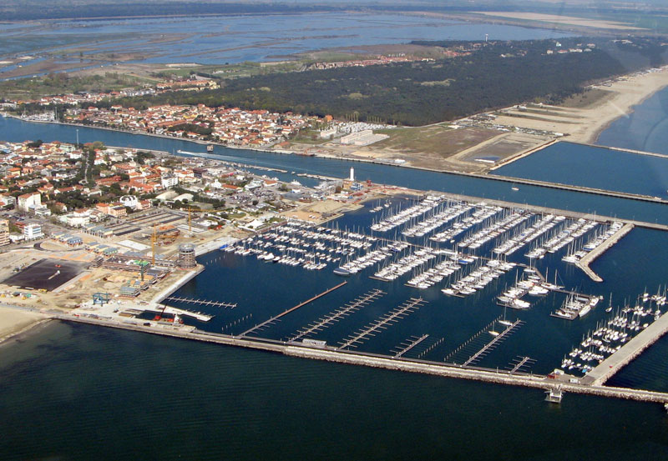
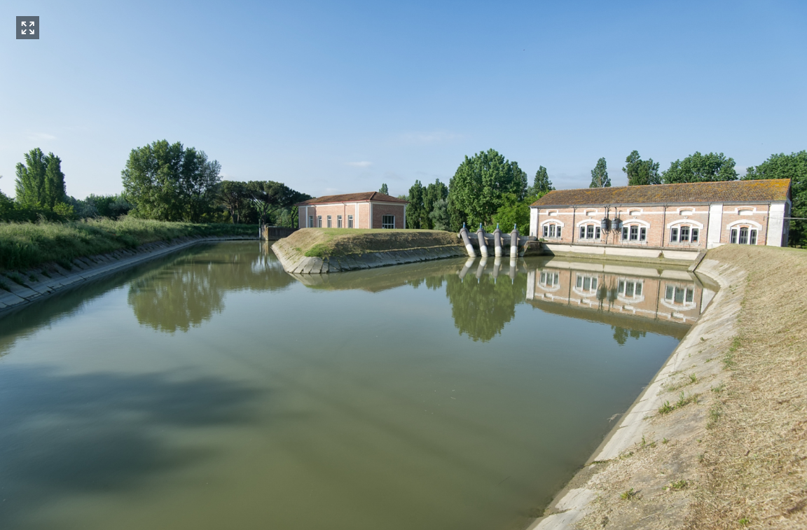
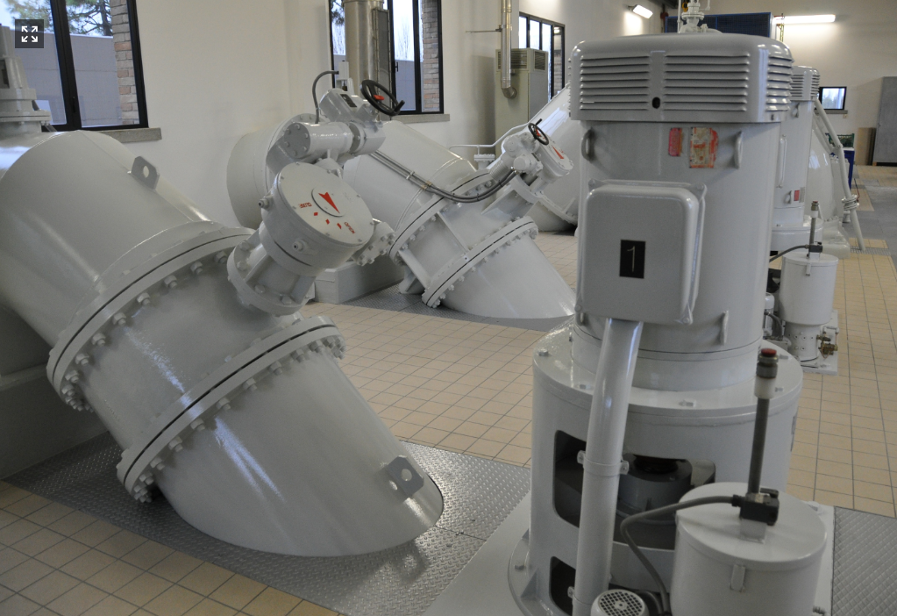
Brief Introduction
The coastal areas are major climate change hotspots, because they are easily susceptible to the impacts of climate extreme events such as sea-level rise, storm surge, frequent inundation, rainfall variability and more (Nicholls et al., 2007).
As a result, coastal cities worldwide often rely on mitigation measures such as drainage channels, dams, levees, seawalls, polders, pumping stations, and more (Ogie et al., 2018).
On the other hand, the appealing nature of the coast has accelerated human migration to the coastal areas, promotes rapid urbanization and tourist resorts, among other major development.
Source: https://www.bonificaromagna.it/index.php/multimedia
3/20
Laurea Magistrale in Analisi e Gestione dell’Ambiente, WATER AND COASTAL MANAGEMENT (WACOMA )

Slide 4
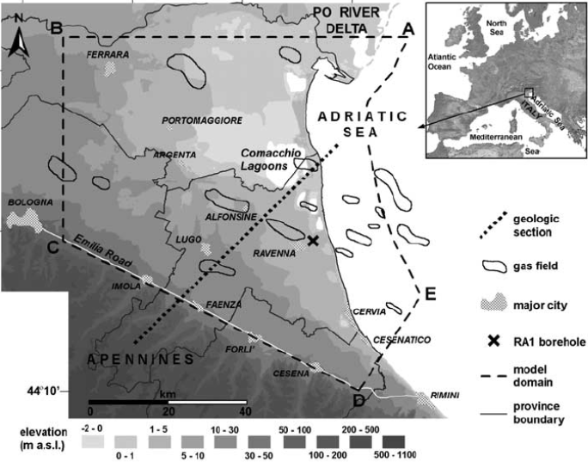
Problem Statement
The coastal basins considered for this research have the following major characteristics;
Low-lying topography and below sea level – exposing the coastal basins to unfavorable meteorological extremes (Cerenzia et al., 2016; Perini et al., 2017).
Land subsidence - both natural and anthropogenic phenomena*** (Bitelli et al., 2015; Carminati and Martinelli, 2002; Teatini et al., 2005).
>>> still sinking (Artese et al., 2016, Cerenzia et al., 2016)
Adapted from Teatini et al. 2006
Laurea Magistrale in Analisi e Gestione dell’Ambiente, WATER AND COASTAL MANAGEMENT (WACOMA )
4/20
4/20

Slide 5
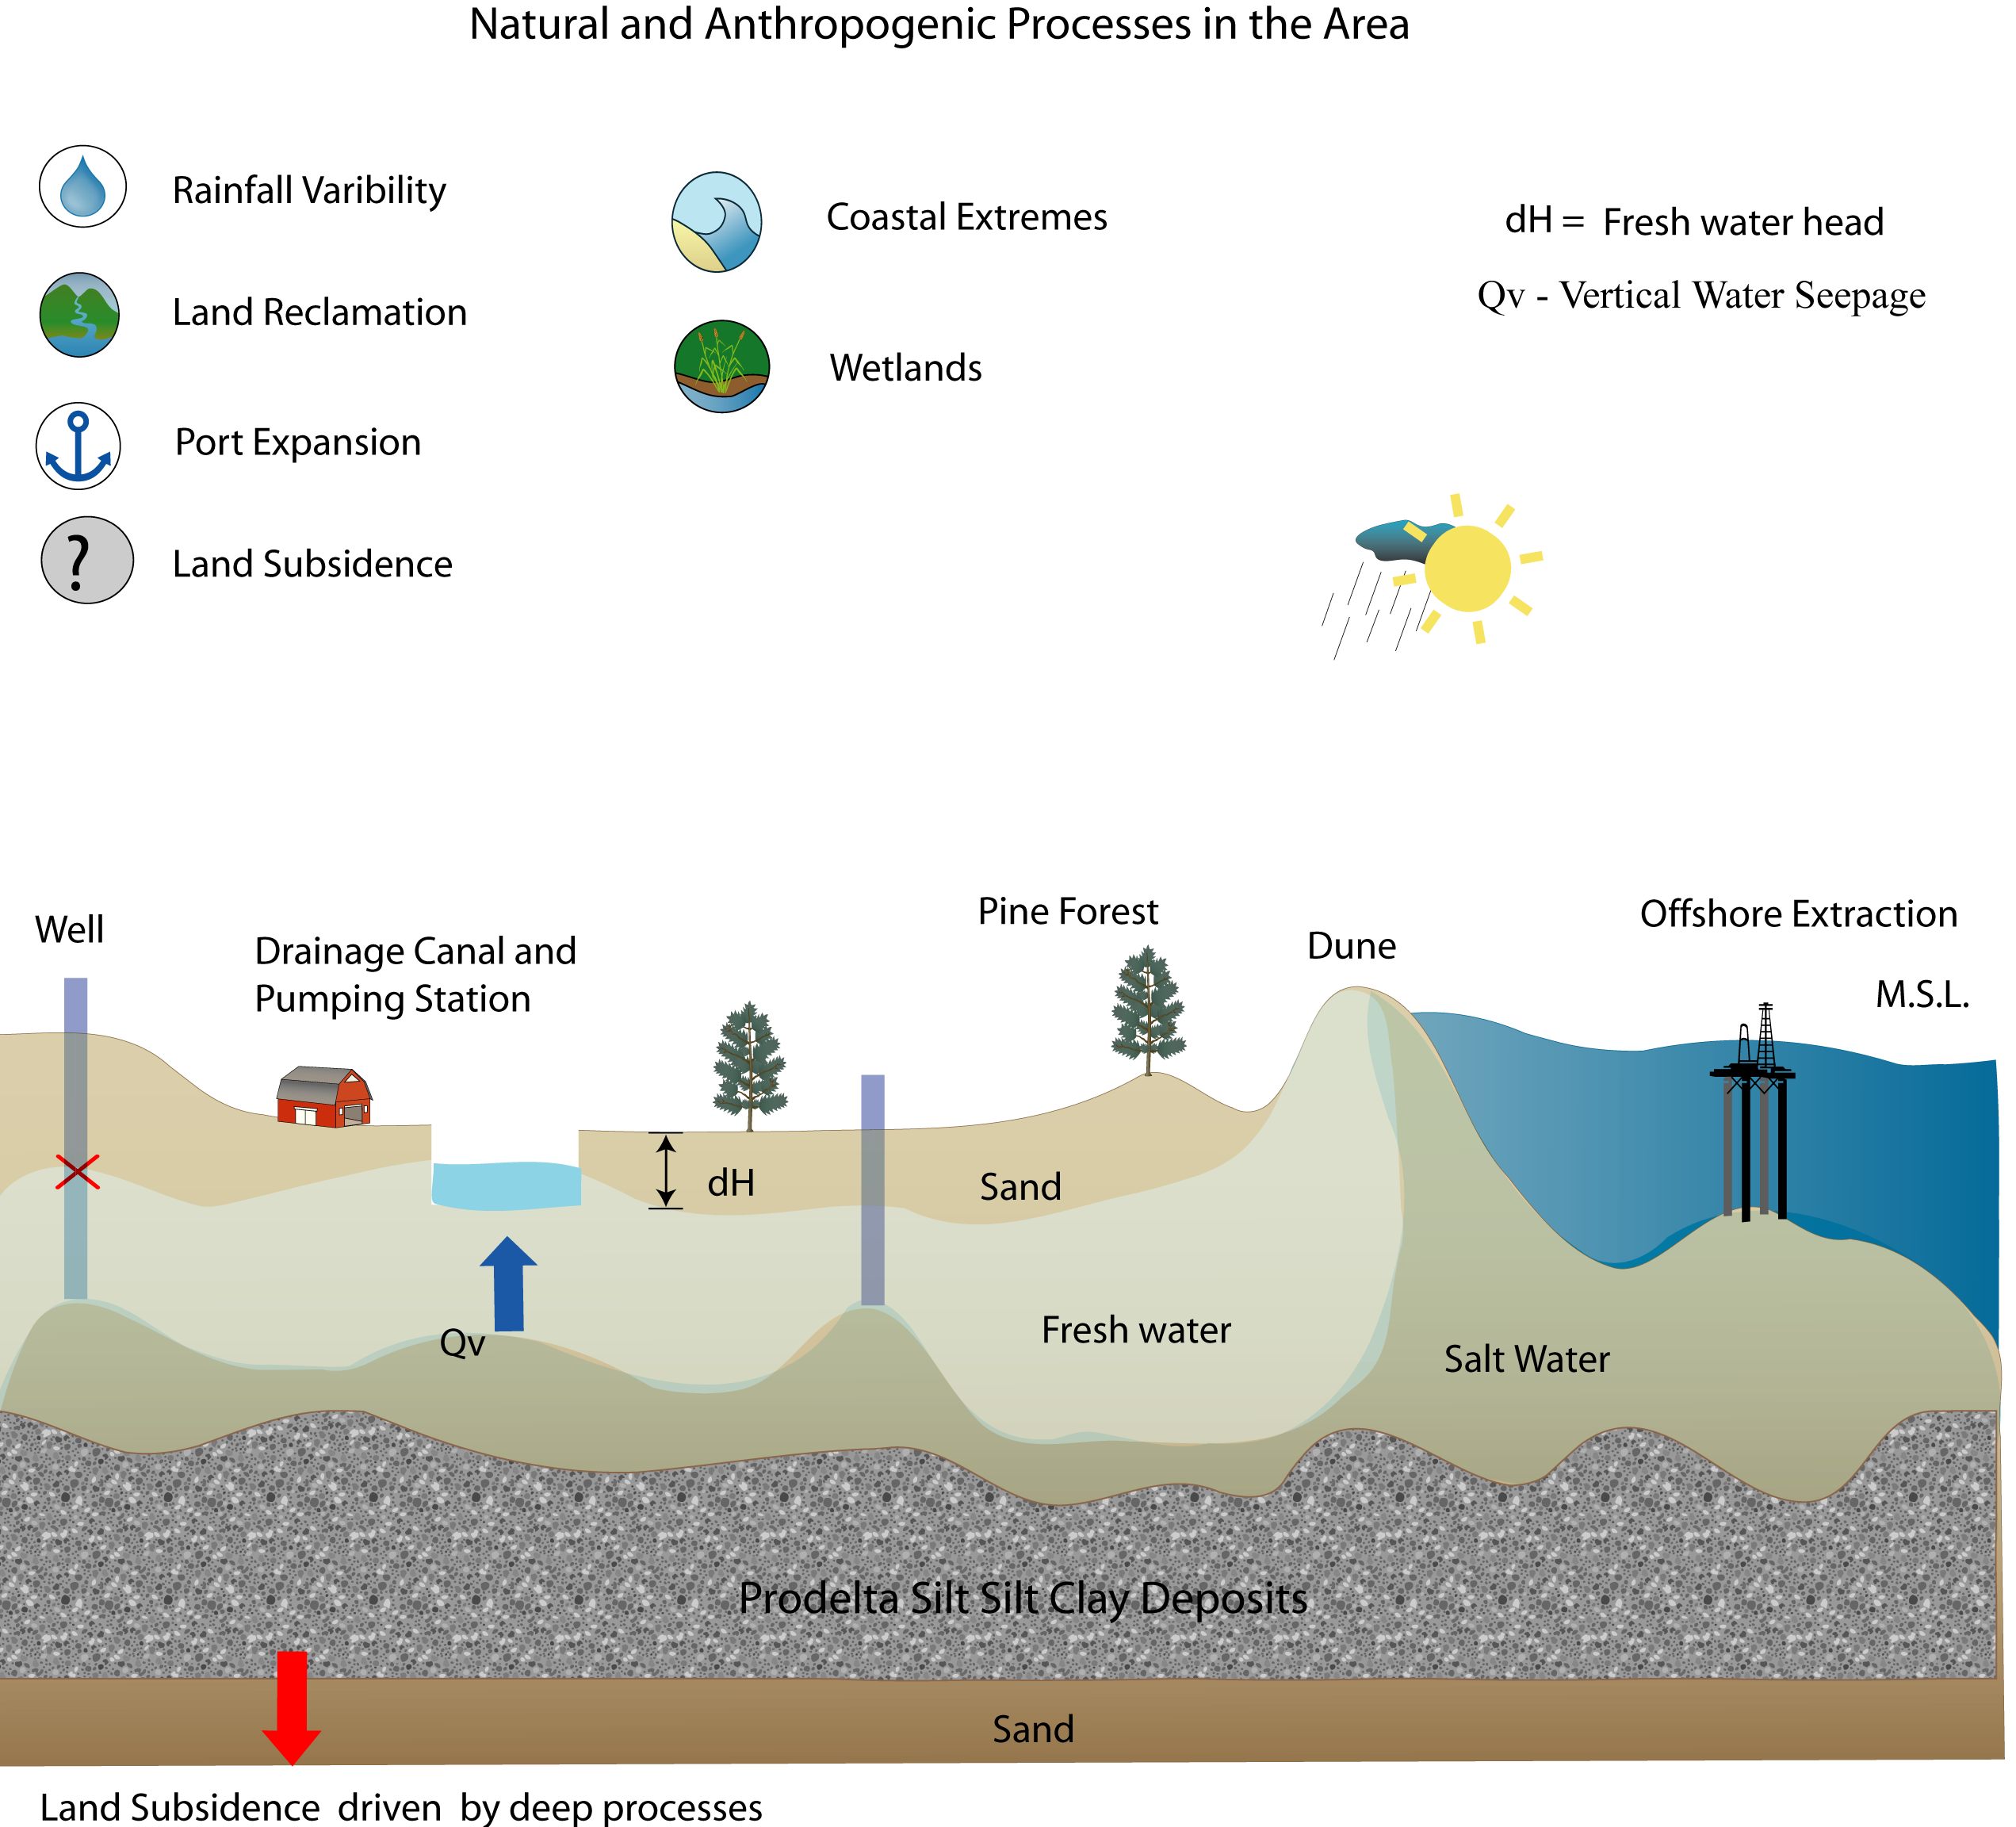
Problem Statement
Aquifer salinization – the freshwater availability in the low-lying coastal areas is becoming scarce due to limited precipitation, severe drainage, saline intrusion, and long periods of drought (Antonellini et al., 2015, 2008).
Imbalance annual water budget - deficit during the summer and surplus in the winter (Benini et al., 2016; Greggio et al., 2018).
5/20
Laurea Magistrale in Analisi e Gestione dell’Ambiente, WATER AND COASTAL MANAGEMENT (WACOMA )

Slide 6
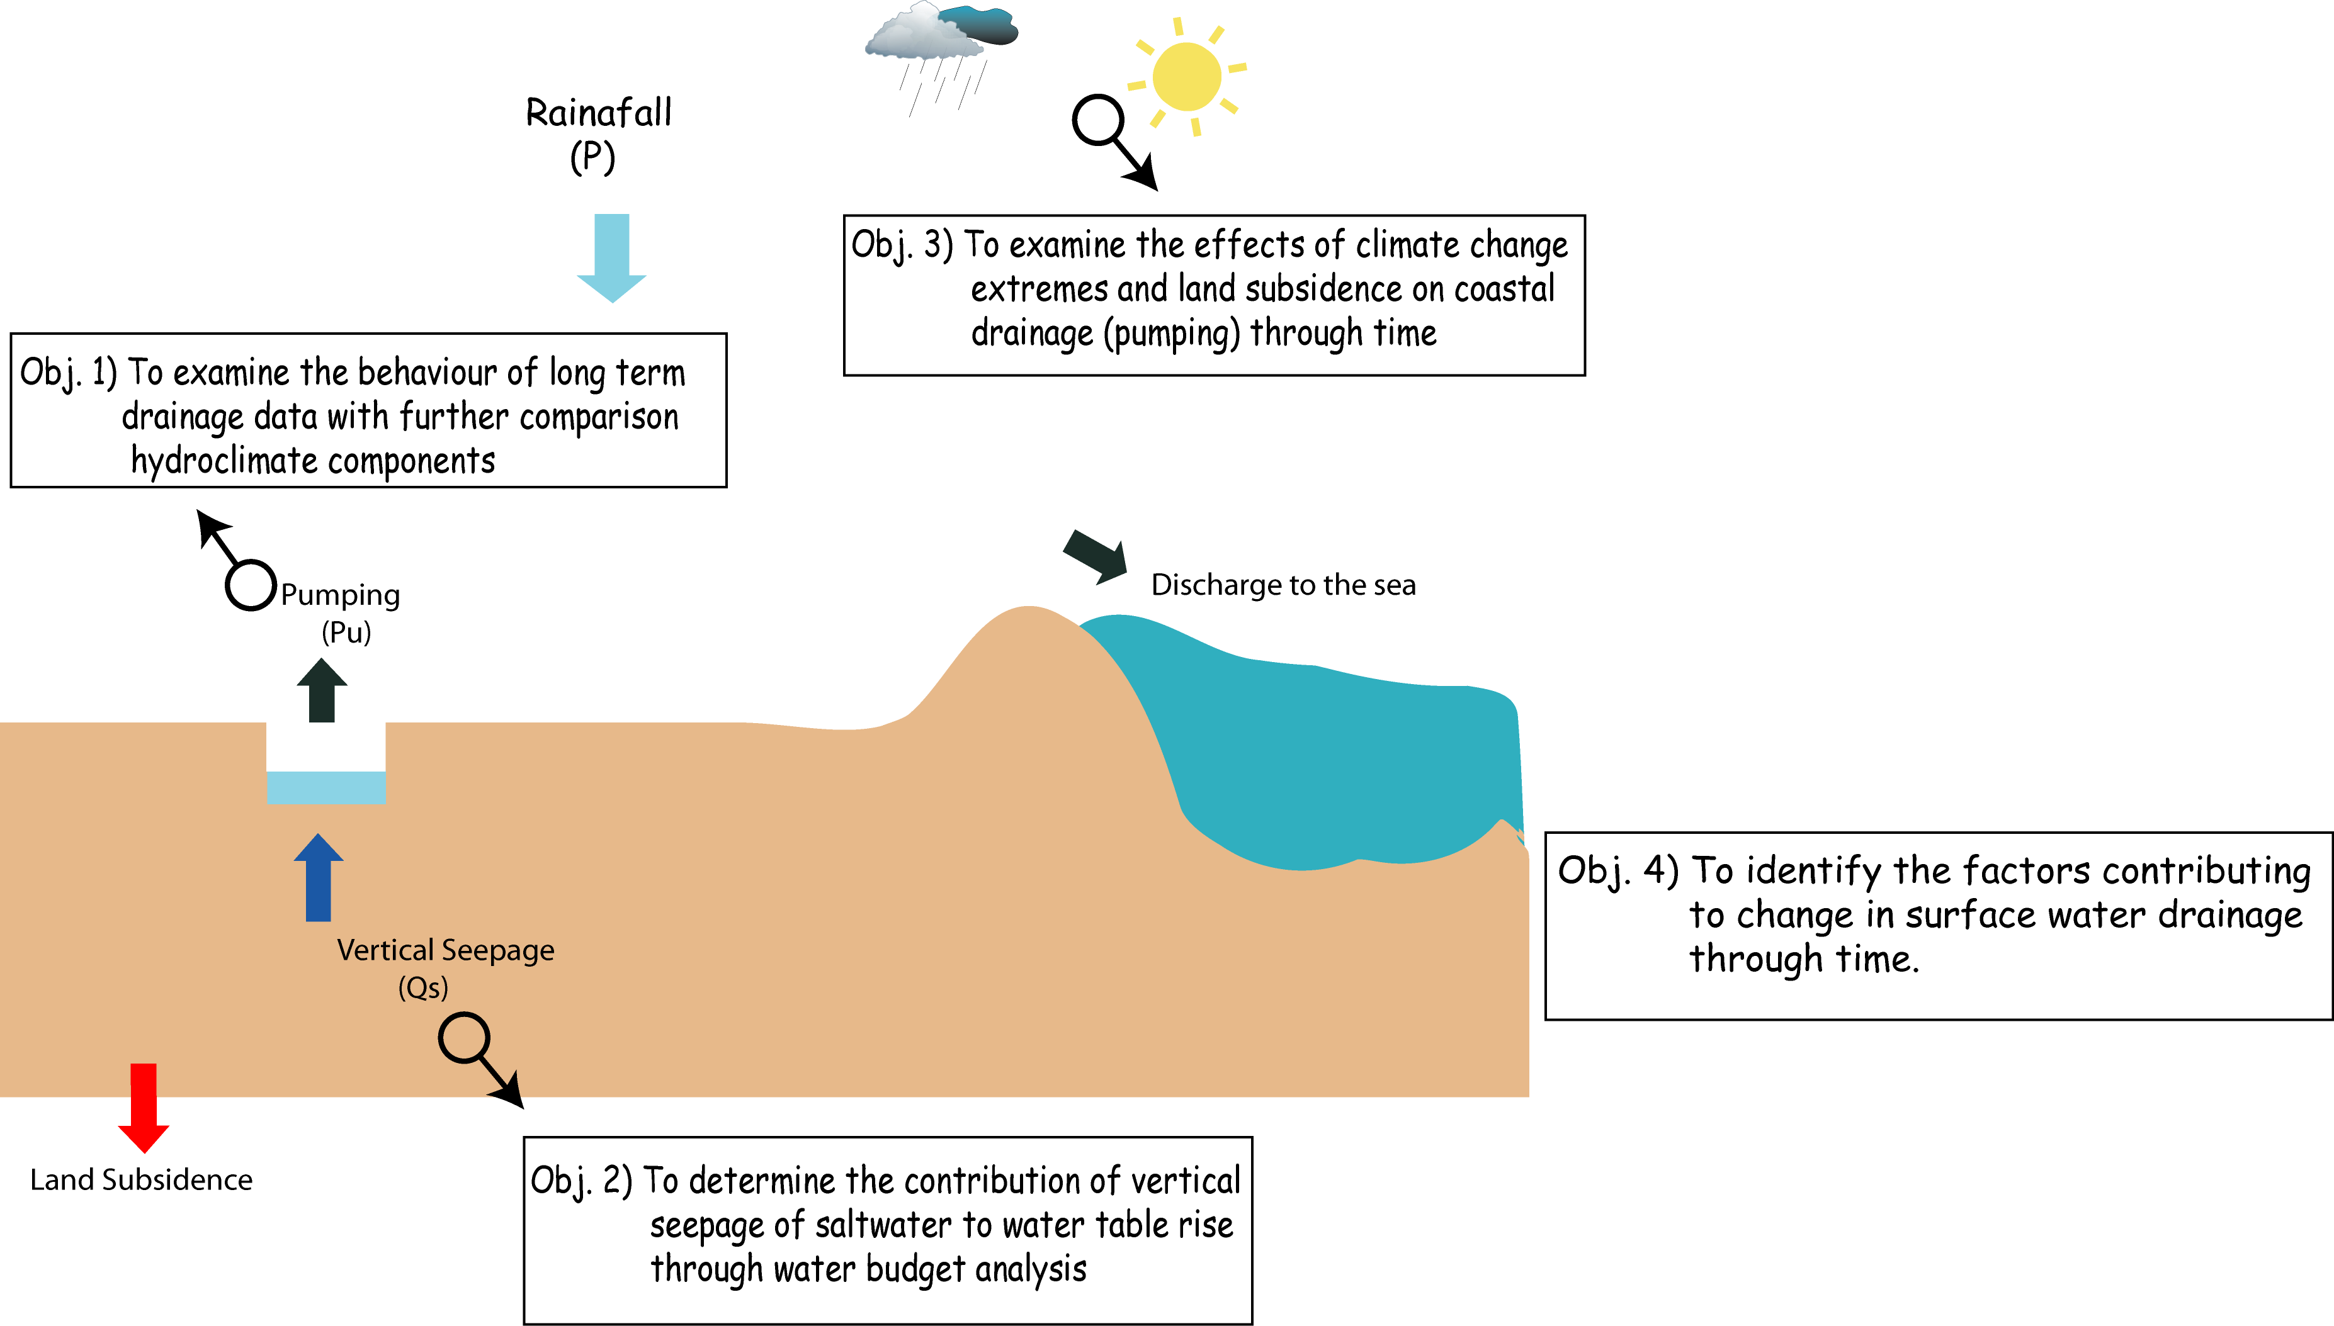
Purpose of Research
The study aims to analyze the coastal drainage (pumping) data of the low-lying coastal basins of Ravenna from 1971 to 2018 apropos to climate change extremes and land subsidence.
6/20
Laurea Magistrale in Analisi e Gestione dell’Ambiente, WATER AND COASTAL MANAGEMENT (WACOMA )

Slide 7
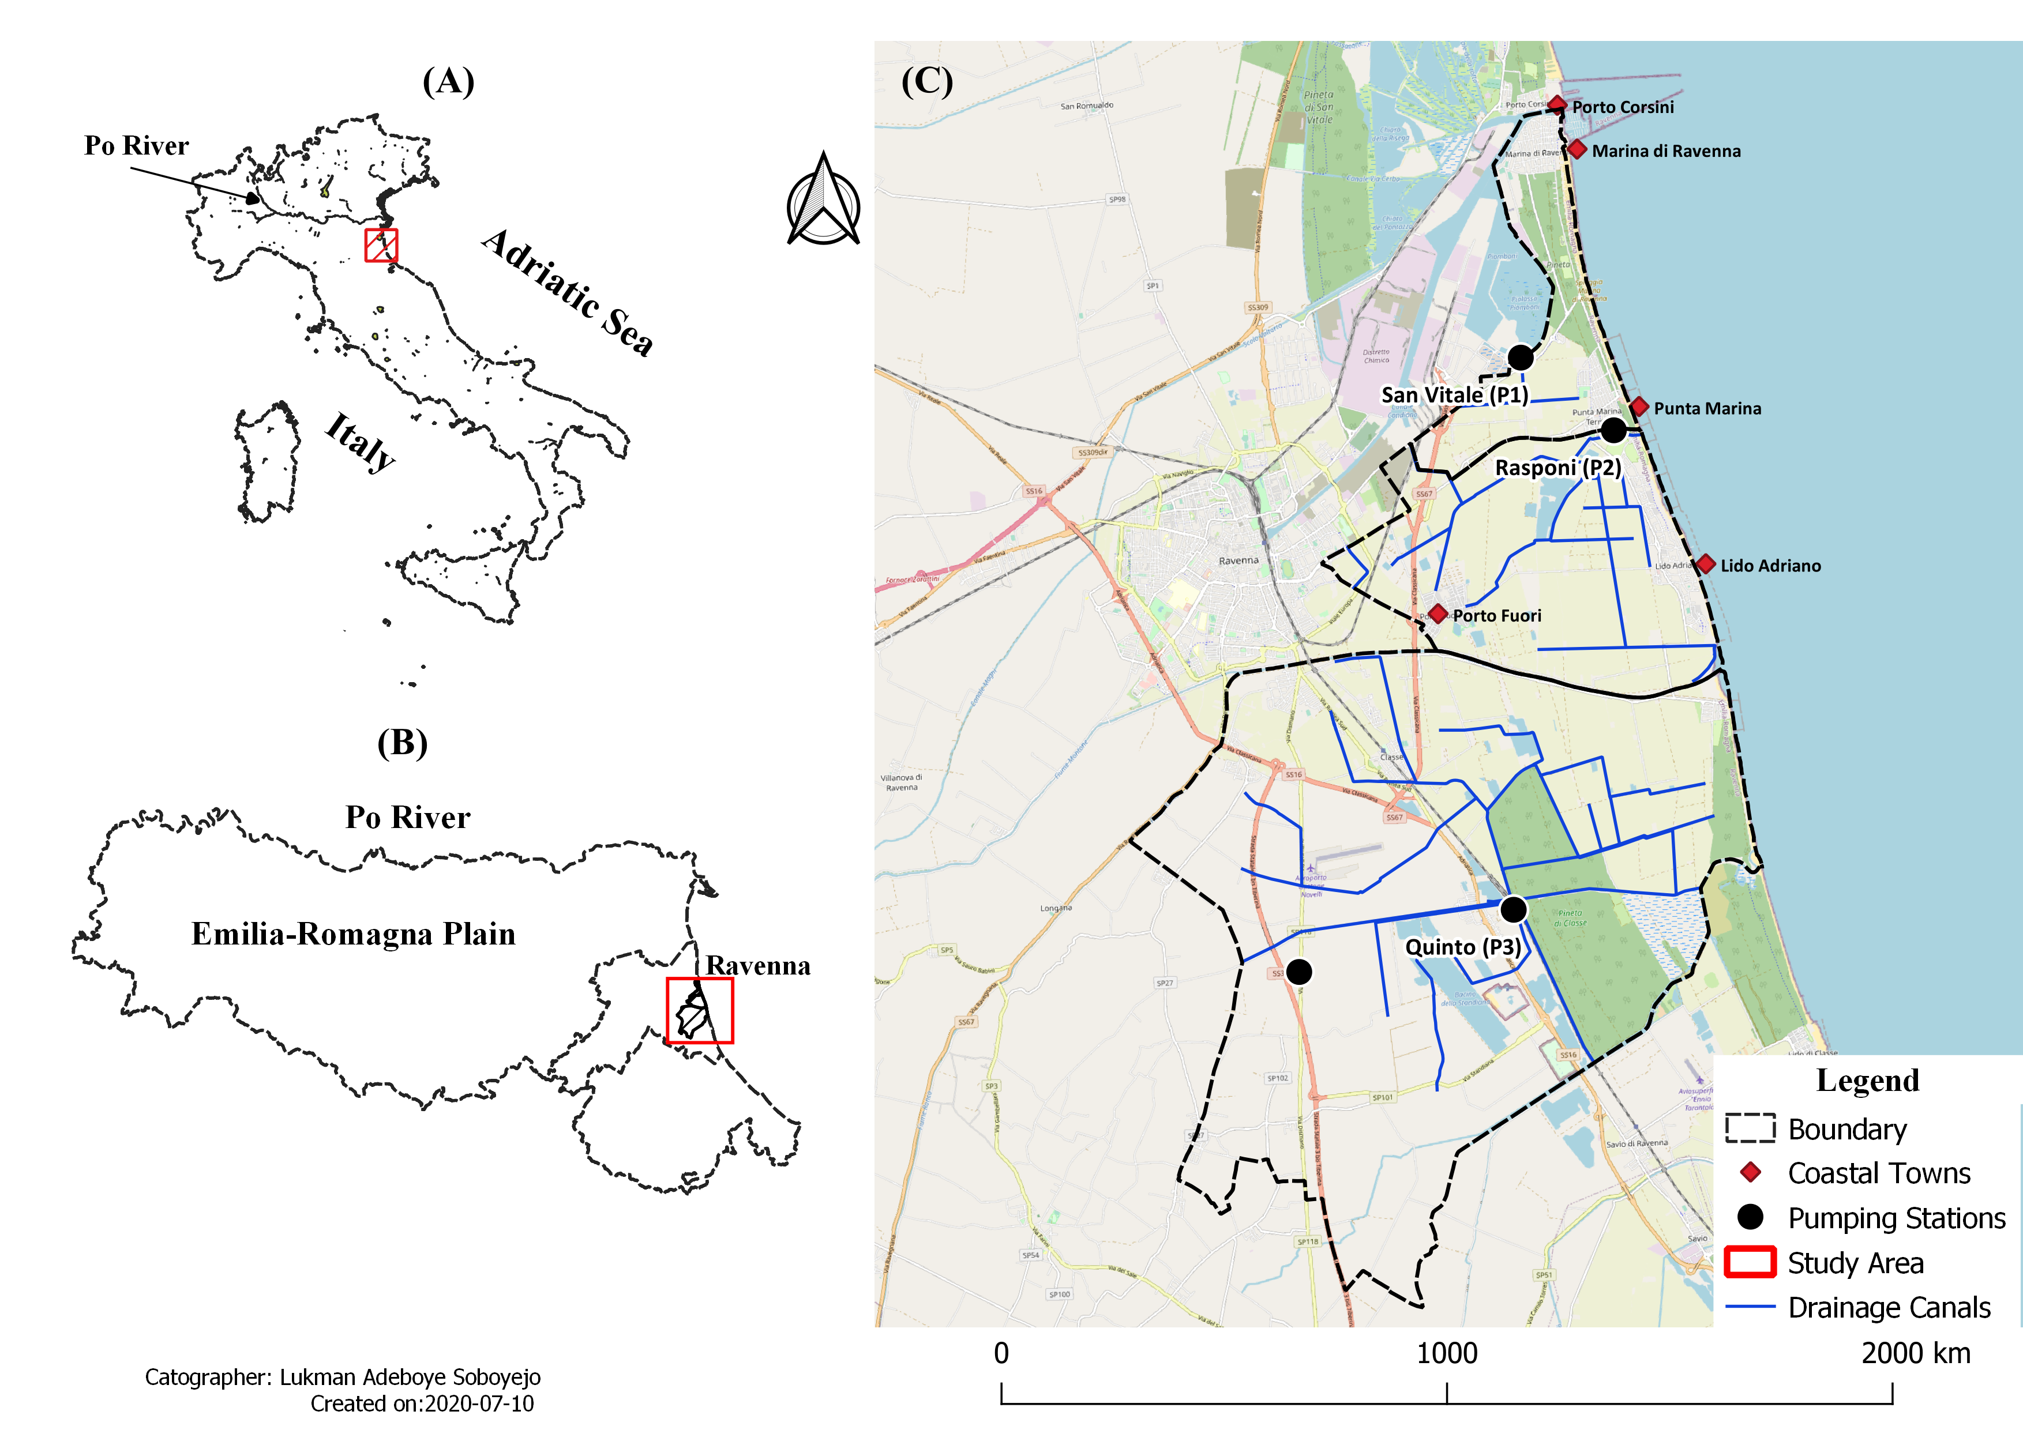
Study Area
The Ravenna City is in a low-lying coastal plain situated in the eastern end of Emilia-Romagna plain (North-Eastern Italy), about 60 km south of the Po River, directly facing the Adriatic Sea.
Maps showing the study area; (a) location showing the study site along the Adriatic Coast and the Po River (b) location showing the Emilia-Romagna Plain and the low-lying coastal basins, and (c) location showing pumping stations, rivers, and surface drainage network.
Laurea Magistrale in Analisi e Gestione dell’Ambiente, WATER AND COASTAL MANAGEMENT (WACOMA )
7/20

Slide 8
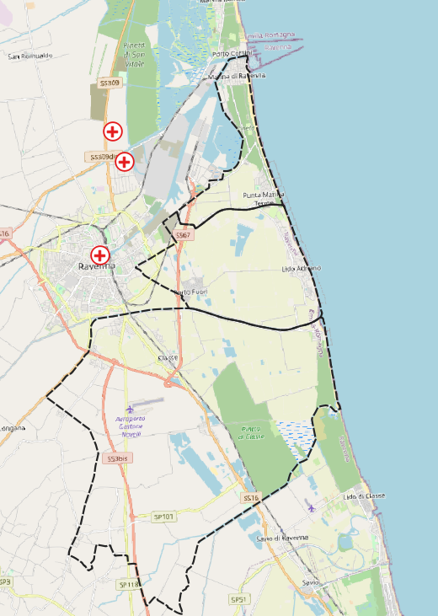

Data Acquisition
Daily Weather Data (1971 – 2018)
Precipitation and Temperature
ARPAe published annal (1971 to 1975)
Daily Drainage Data (1971 - 2018)
Obtained from Land Reclamation Authority
Missing data; San Vitale and Rasponi basins (1988 to 1991)
Inter Basin Water transfer from Rasponi to San Vitale basin starting from 2000 till date
Subsidence Data – at interval (1972 to 2016)
Obtained from literature (1972 to 1992) – (Teatini et al, 2015)
ARPAe online database (1992 to 2016)
Le Bassette
(2002 to 2003).
SAN VITALE
BASIN
Azienda Agricola Marani
(1976 to 2002).
RASPONI
BASIN
Ravenna Urbana”
(2003 to 2018).
QUINTO
BASIN
Weather Stations
Laurea Magistrale in Analisi e Gestione dell’Ambiente, WATER AND COASTAL MANAGEMENT (WACOMA )
8/20

Slide 9
Methodology
The study employed different statistical methods to analyze the coastal drainage data (time series analysis), the subsidence survey (QGIS elaboration), and the daily meteorological data (using RClimdex and ClimPACT software) between 1971 and 2018.
Computed Empirically;
Potential evapotranspiration, PET (Thornthwaite method, 1948)
Actual evapotranspiration, AET (Thornthwaite- Maher procedure, 1957)
The rate of pumping in the low-lying coastal basins (calculation)
the daily drained water per day: DDW (m³/day) = flow rate of pumps, Q (m³/hr) × duration of pumping, D (hr)
the total amount of water drained per day: TDW (m³/day) = ΣDDW (m³/day)
The equivalent depth of water per day: EDW (m/day) = TDW (m³/day) ÷ Area of the individual basin (m²)
The pumping rate in mm/day: EDW (mm/day) = EDW (m/day) × 1000 (repeated for all basins)
Annual or monthly value is the summation of the EDW.
Laurea Magistrale in Analisi e Gestione dell’Ambiente, WATER AND COASTAL MANAGEMENT (WACOMA )
9/20

Slide 10
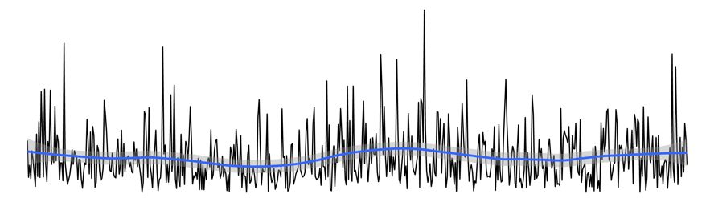
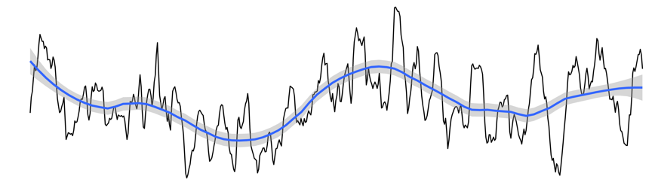
Methodology
Time series Analysis (monthly and annual data)
Long-term series: centered moving average and seasonality analysis
The components analyzed include pumping data and hydroclimate component such as rainfall etc.
Why?
Real Data
The blue line is a locally fitted non-parametric curve used to produce a smoothed model surface with the loess method.
moving average line
Laurea Magistrale in Analisi e Gestione dell’Ambiente, WATER AND COASTAL MANAGEMENT (WACOMA )
10/20

Slide 11
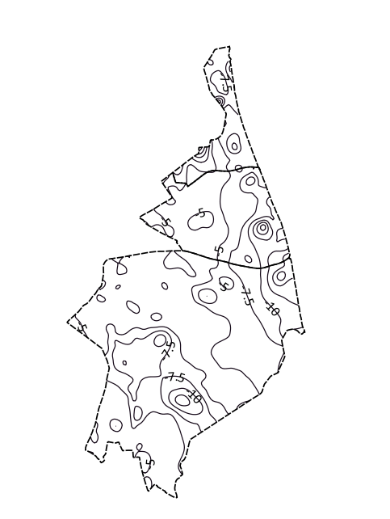
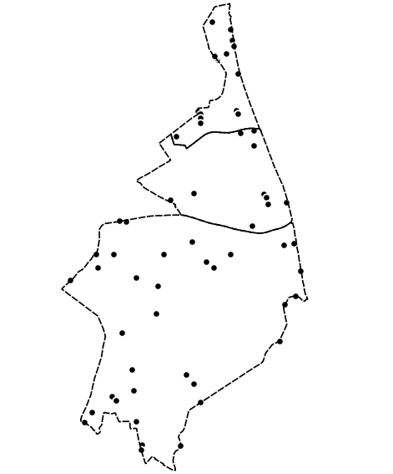
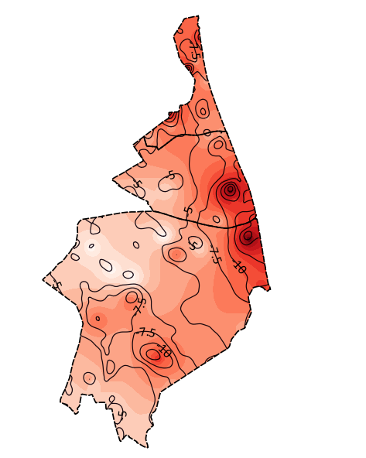
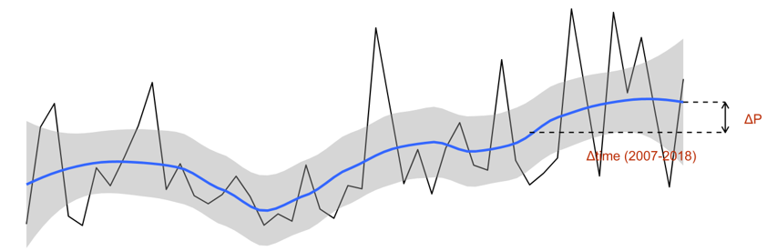
Methodology
Subsidence (using QGIS elaboration)
Statistical Processing tool to calculate the subsidence rate in each basin (mm/yr)
Isokinetic lines generated by ARPAe.
Converted into vector points
Interpolated Distance Weight (IDW) algorithm
Water Budget Analysis (Modeled Annual data)
Annual time series modelling of water budget components – loess method.
To determine the contribution of saltwater vertical seepage for different sub-periods
…and a 95% confidence interval shown in grey shading.
Laurea Magistrale in Analisi e Gestione dell’Ambiente, WATER AND COASTAL MANAGEMENT (WACOMA )
11/20

Slide 12
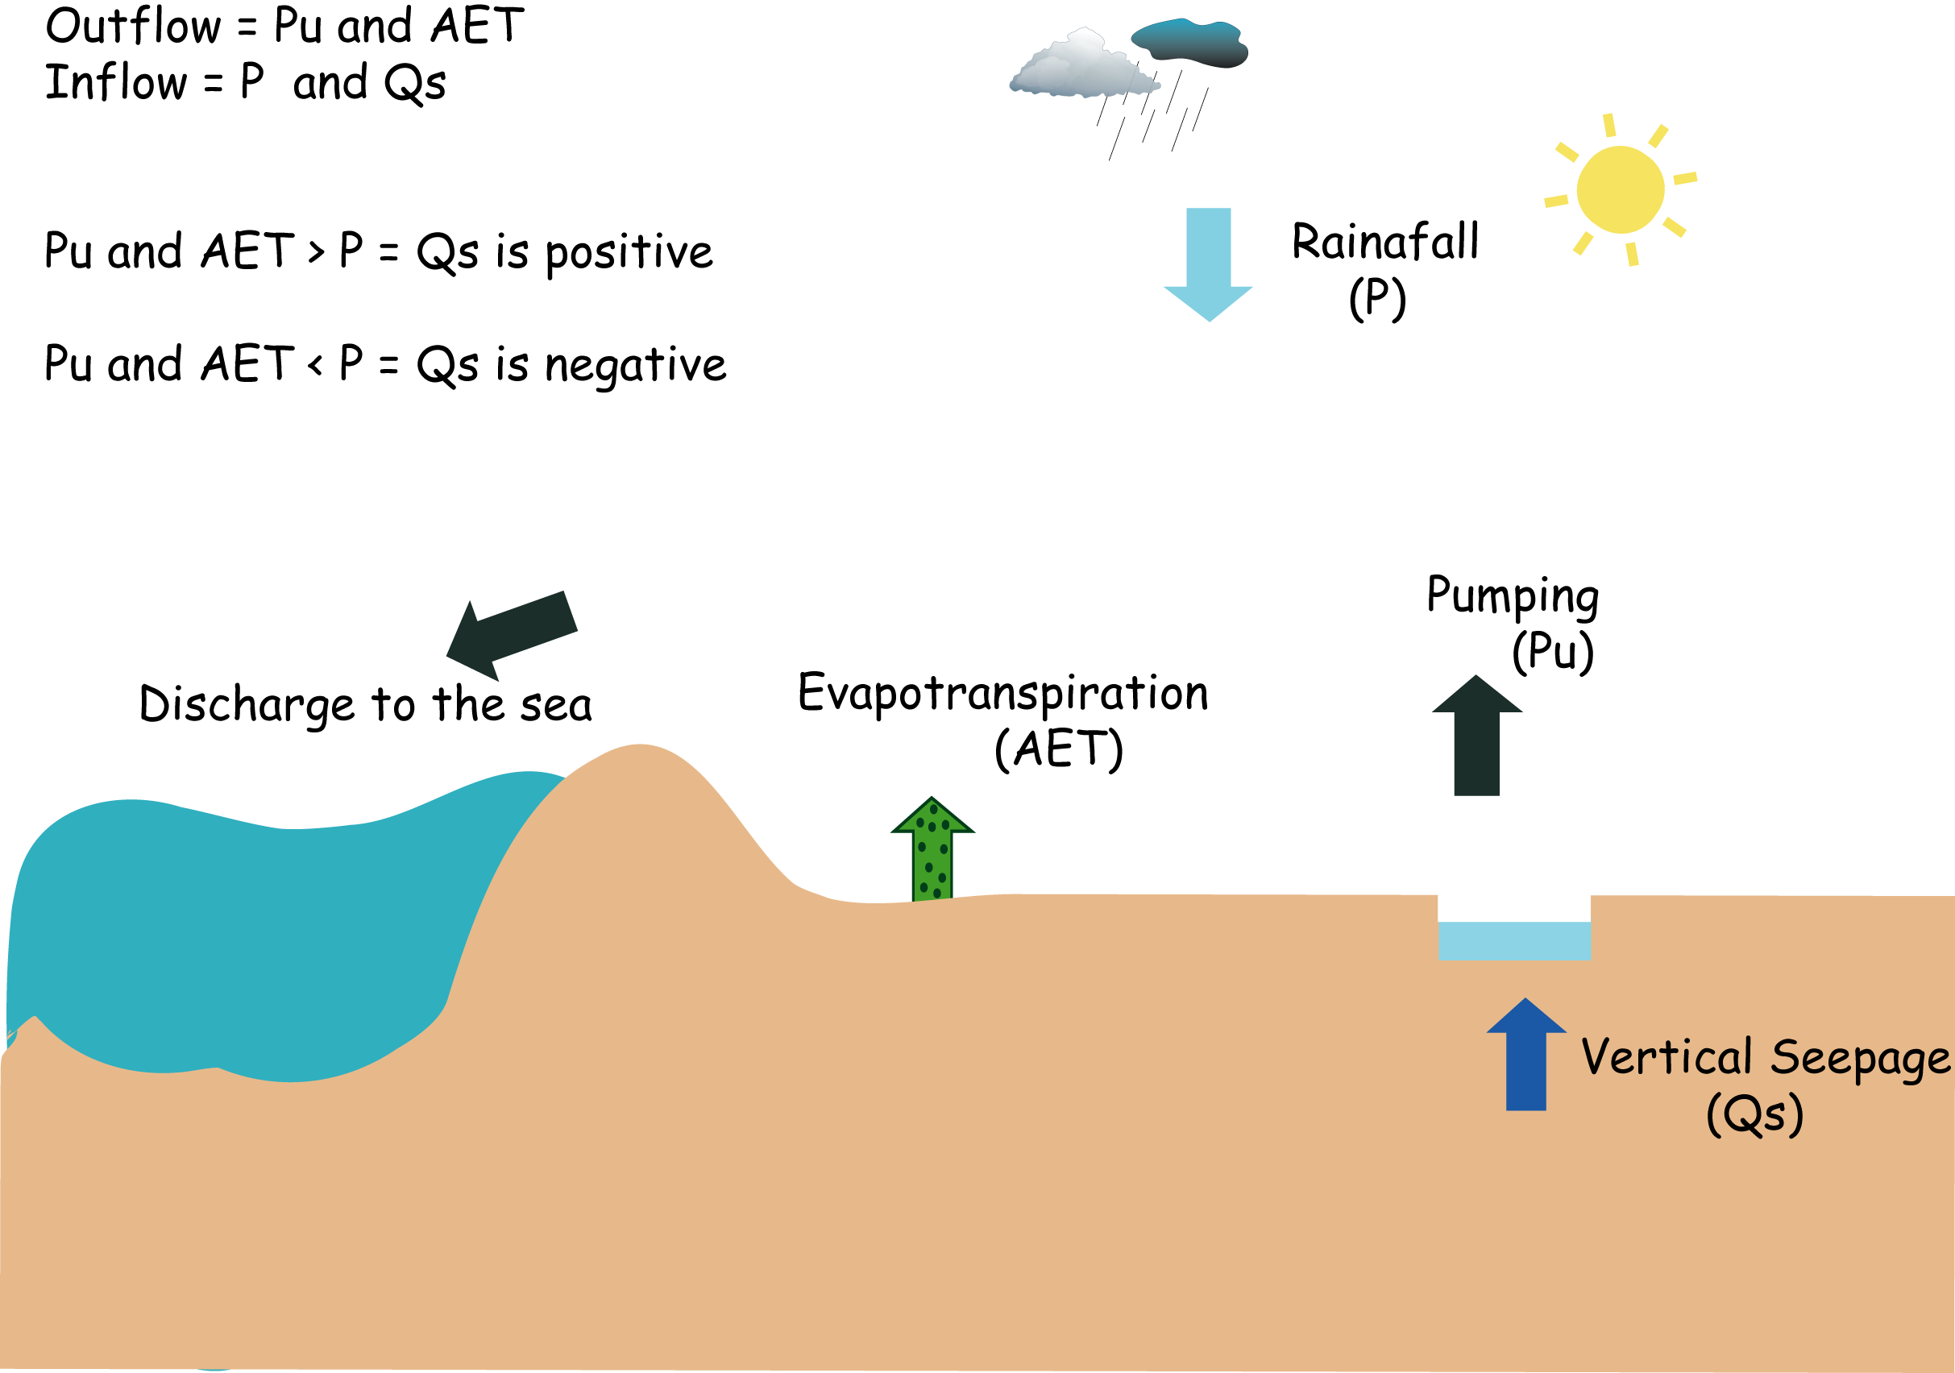
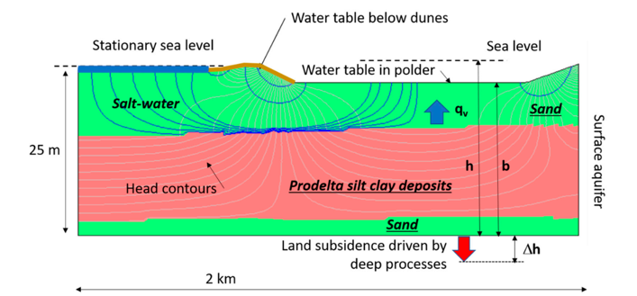
Methodology
>>> Water Budget Calculation
General formula adopted for each basin;
ΔQs = (ΔETR + ΔPu[basin]) – ΔP
The upward or downward flow through the unconfining layer causes the water table in that layer to rise or fall. Rainfall and evapotranspiration also affect the elevation of the water table (De Ridder and Zijlstra, G, 1994)
The conceptual diagram is showing the cross-section of the shallow unconfined coastal aquifers (image borrowed from Giambastiani et al; 2020) on the left (water budget conceptual model).
Laurea Magistrale in Analisi e Gestione dell’Ambiente, WATER AND COASTAL MANAGEMENT (WACOMA )
12/20

Slide 13
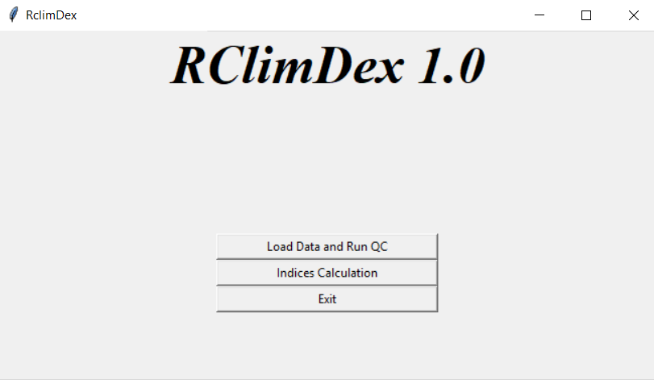
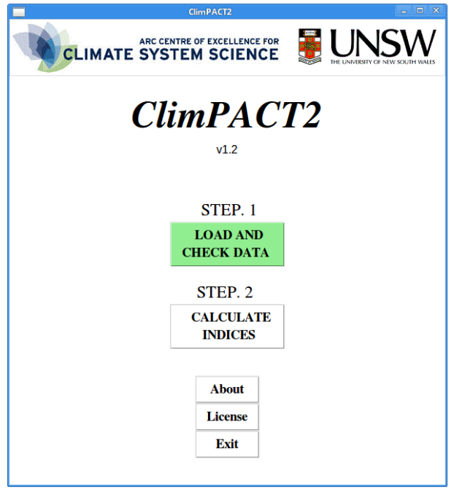
Methodology
Climate Extremes Calculation
The study used a descriptive core set of 13 temperatures and 10 precipitation indices from the list of Expert Team on Climate Change Detection and Indices (ETCCDI) indices and 2 additional drought indices from the Expert Team on Sector-specific Climate Indices (ET-SCI).
Drought indices include SPI and SPEI proposed and developed by (McKee et al., 1993) and (Vicente-Serrano et al., 2012), respectively.
Certain conditions need to be met (Data Processing, Quality Control, User Defined threshold)
Laurea Magistrale in Analisi e Gestione dell’Ambiente, WATER AND COASTAL MANAGEMENT (WACOMA )
13/20

Slide 14
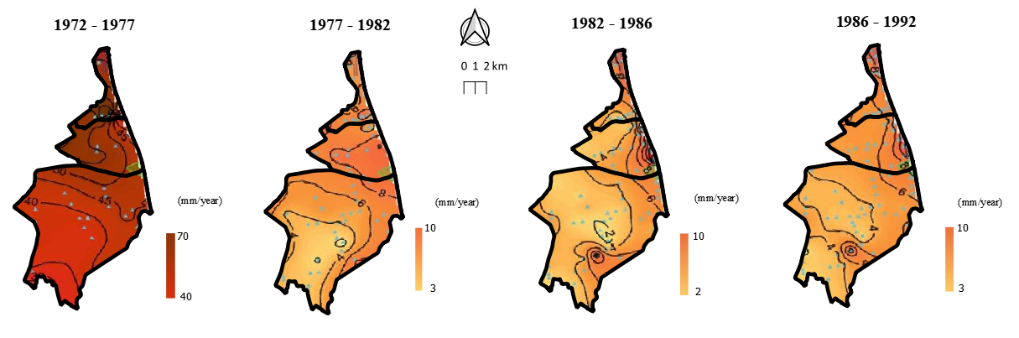
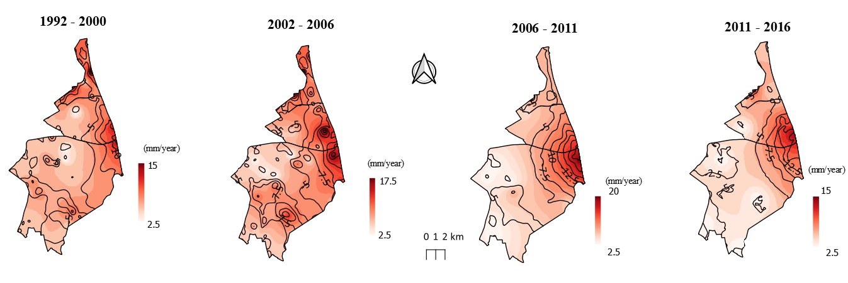
Result and Discussion
3. The San Vitale basin has maintained its stability in the last 15 years (~2.5 mm/year).
1. The rate of subsidence for sub-period of 1972 - 1982 remains the highest recorded rate of subsidence (> 80 mm/yr) in the last half-century.
2. Recently, the area inland is more stable than the area along the coast (~20 mm/yr), particularly in the Quinto and the Rasponi basins.
A subsidence map of low-lying coastal basins showing the severity of subsidence from 1972 to 2016.
Laurea Magistrale in Analisi e Gestione dell’Ambiente, WATER AND COASTAL MANAGEMENT (WACOMA )
14/20

Slide 15
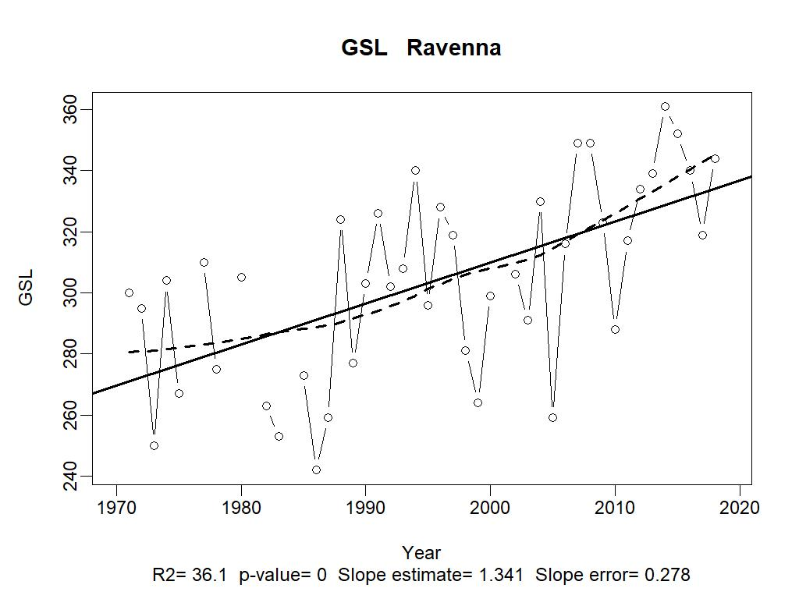
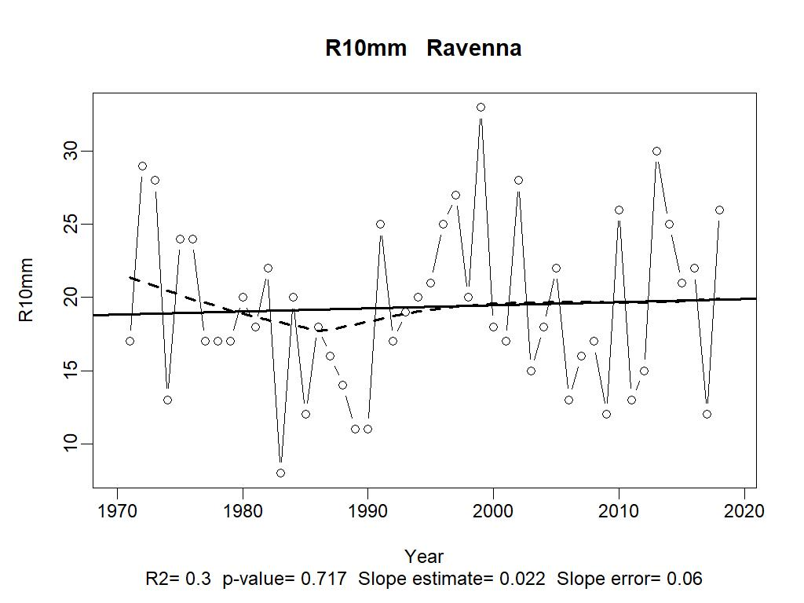
Result and Discussion
Most of the extreme temperature indices examined are significant in trend. These include the hottest day (TXx), hottest night (TNx), the length of time in which plants can grow (GSL) and the number of days contributing to a warm period, at least 6 days long (WSDI), the days when the maximum temperature exceeds 25°C (SU-25) […]
All rainfall extremes indices examined are insignificant in trend. These includes longest wet spell (CWD), days when rainfall is at least 10 mm or 20 mm, (R10mm or R20mm) and the average daily wet-day rainfall intensity (SDII), the total wet-day rainfall (PRCPTOT), the longest dry spell (CDD), the maximum amount of rain that falls in 5-consecutive days (RX5day) […].
(Trend example) - Annual temperature extremes index (top) and rainfall extreme index (bottom)
Laurea Magistrale in Analisi e Gestione dell’Ambiente, WATER AND COASTAL MANAGEMENT (WACOMA )
15/20

Slide 16
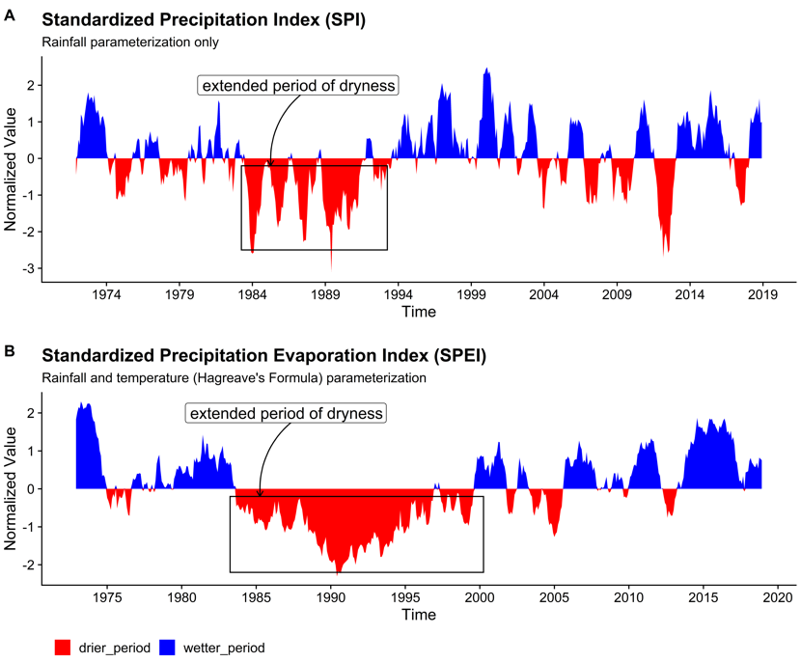
Result and Discussion
Monthly series for drought indices in the low-lying areas; (a) SPI (b) SPEI from 1971 to 2018. Positive SPI values indicate higher than median precipitation, whereas negative values indicate less than median precipitation. The magnitude of departure from zero represents a probability of occurrence (Hayes et al., 1999).
Laurea Magistrale in Analisi e Gestione dell’Ambiente, WATER AND COASTAL MANAGEMENT (WACOMA )
16/20

Slide 17
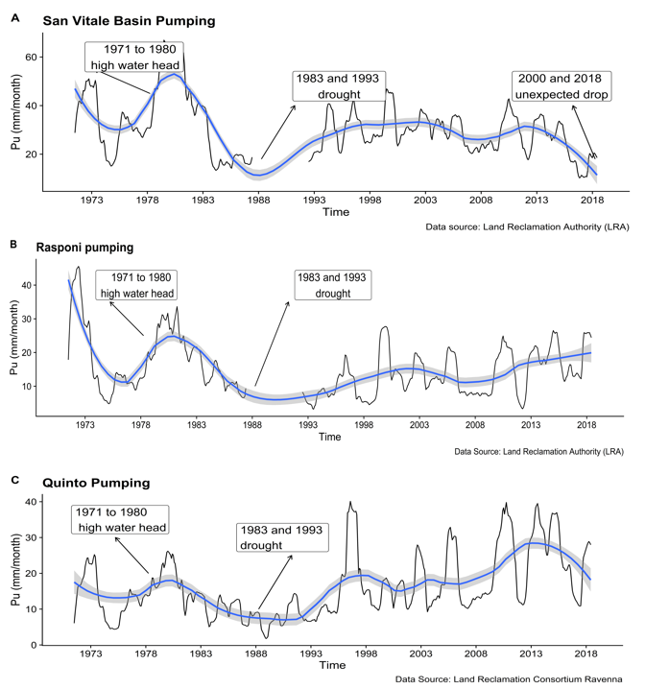
Result and Discussion
The reason for the high drainage in the first decade is related to compound conditions
These includes incomplete drainage of wetlands and flooding caused by severe land subsidence, and coastal extremes such as sea storms.
A monthly time series showing pumping from 1971 to 2018 (in mm/month).
17/20
Laurea Magistrale in Analisi e Gestione dell’Ambiente, WATER AND COASTAL MANAGEMENT (WACOMA )

Slide 18
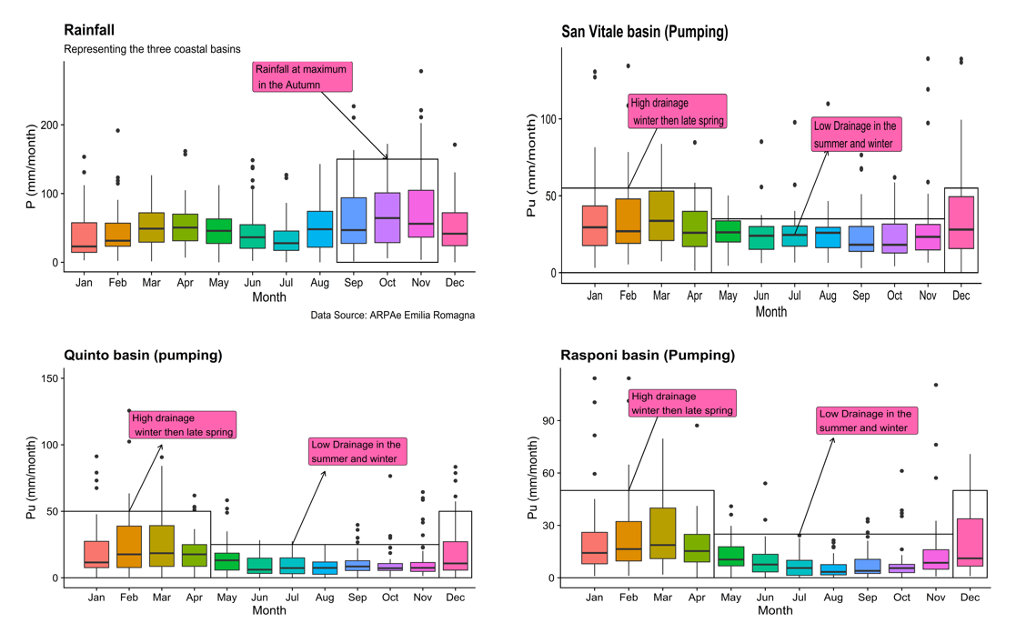
Result and Discussion
High rainfall in the autumn (Sept – Nov) and surface drainage is very low in all the low-lying basins. ??
In the subsequent months, the pumping rate reaches its maximum peak in the winter. ??
Seasonality boxplots showing monthly rainfall in the three coastal basins and the pumping rate trends
18/20
Laurea Magistrale in Analisi e Gestione dell’Ambiente, WATER AND COASTAL MANAGEMENT (WACOMA )

Slide 19
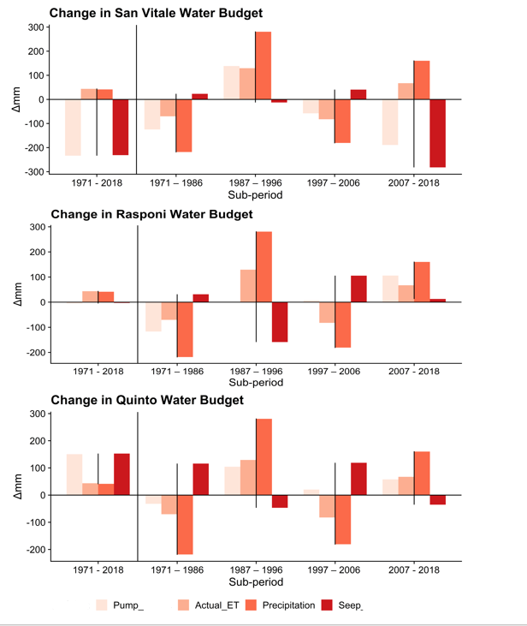
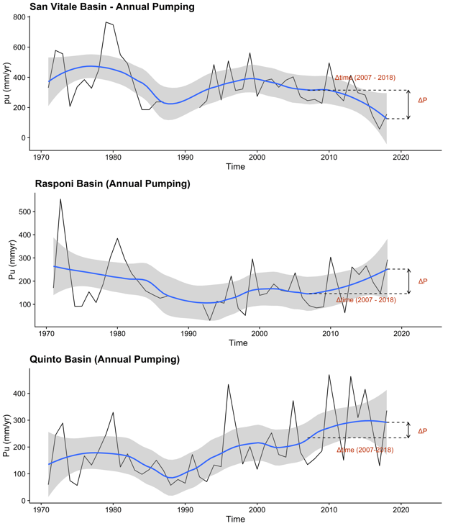


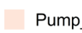
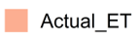
Result and Discussion
The amount of water leaving the system (AET and Pu) is sometimes higher than precipitation (P) – the vertical seepage (Qs) of saline water into the basins is sometimes positive.
Laurea Magistrale in Analisi e Gestione dell’Ambiente, WATER AND COASTAL MANAGEMENT (WACOMA )
19/20

Slide 20
Conclusions
The evolution of drainage in the low-lying coastal basins is influenced by
land subsidence, drought period, and saltwater seepage.
Beyond landmark events like severe anthropic subsidence and an extended period of drought that occurred in the early decades
the drainage rate in the coastal basins begins to increase slightly from 1993 with a marginal rise in the rainfall (at least in the Rasponi and Quinto basins).
the three coastal basins behaves differently to changes (more studies need to be conducted)
At seasonal timescale, the rate of pumping in the coastal basins strongly depends on antecedent rainfall.
the coastal basins are characterized by water deficits in the summer and surplus in the winter when drainage is at maximum.
The extreme events analysis revealed that the temperature warming extremes have a more significant influence on drainage through time than the rainfall extremes because the latter are less significant (weak trends).
The drought indices (SPI and SPEI) highlighted a straightforward correlation of rainfall deficit with the drainage pattern.
Laurea Magistrale in Analisi e Gestione dell’Ambiente, WATER AND COASTAL MANAGEMENT (WACOMA )
20/20

Slide 21
Thank you for your attention!

